Slide 1



JSPM’s
Imperial College of Engineering and Research,Wagholi,Pune.
(Approved by AICTE,Delhi & Govt. of Maharashtra, affiliated to Savitribai Phule Pune University)
Gat.No.720,Pune-Nagar Road,Wagholi,Pune,412207
Department of Electronics and Telecommunication Engineering
JSPM’s
Imperial College of Engineering and Research,Wagholi,Pune.
(Approved by AICTE,Delhi & Govt. of Maharashtra, affiliated to Savitribai Phule Pune University)
Gat.No.720,Pune-Nagar Road,Wagholi,Pune,412207
Department of Electronics and Telecommunication Engineering
A Project Seminar On
“IOT based Air & Sound Pollution Monitoring System Using Raspberry Pi”
Under the Guidance of :
Prof. A. A. Trikolikar
Presented by :
Ambure Chandrashekar
Barure Tukaram
Ghongade Abhishek

Slide 2
JSPM’s
Imperial College of Engineering and Research,Wagholi,Pune.
(Approved by AICTE,Delhi & Govt. of Maharashtra, affiliated to Savitribai Phule Pune University)
Gat.No.720,Pune-Nagar Road,Wagholi,Pune,412207
Department of Electronics and Telecommunication Engineering
Abstract
Introduction
Problem Statement
Objective
Scope of Project
Literature Review
Requirement of Hardware & Software
Block Diagram & description
Circuit Diagram & Description
Advantages
Applications
Model & Obtained Result
References
CONTENTS
‹#›

Slide 3
JSPM’s
Imperial College of Engineering and Research,Wagholi,Pune.
(Approved by AICTE,Delhi & Govt. of Maharashtra, affiliated to Savitribai Phule Pune University)
Gat.No.720,Pune-Nagar Road,Wagholi,Pune,412207
Department of Electronics and Telecommunication Engineering
When air get mixed with harmful gases and substances it is called air pollution and unwanted noise that interferes or harms humans or wildlife is called sound pollution.
The major pollutants of air are gases such as ammonia,corbon monoxide,sulpur dioxide, nitrous oxides, methane etc. and sound pollutants are vehicles, aircraft, industrial machines, loudspeakers, crackers, etc
The sources of pollutants are industrial emission, hazardous emissions form vechicles,burning of fossil fuels etc.
Pollutant air and Sound can causes severe health effects such as heart disease, lungs cancer, high blood pressure, sleep disturbances, and stress etc.
ABSTRACT

Slide 4
JSPM’s
Imperial College of Engineering and Research,Wagholi,Pune.
(Approved by AICTE,Delhi & Govt. of Maharashtra, affiliated to Savitribai Phule Pune University)
Gat.No.720,Pune-Nagar Road,Wagholi,Pune,412207
Department of Electronics and Telecommunication Engineering
Internet of Things (IoT) allows interaction between devices and humans. It forms a communication medium from human to machine.
Previously, data collectors had to travel long distances to the various locations to collect data after which the analysis was done.This was lengthy and time consuming.
But now, sensors and microcontrollers connected to the internet can make environmental parameter monitoring more flexible, accurate and less time consuming.
When the environment merges with sensors and devices to self -protect and self - monitor it forms a smart environment. Embedded intelligence makes the environment interact with the objects.
.
JSPM’s
Imperial College of Engineering and Research,Wagholi,Pune.
(Approved by AICTE,Delhi & Govt. of Maharashtra, affiliated to Savitribai Phule Pune University)
Gat.No.720,Pune-Nagar Road,Wagholi,Pune,412207
Department of Electronics and Telecommunication Engineering
INTRODUCTION
‹#›

Slide 5
JSPM’s
Imperial College of Engineering and Research,Wagholi,Pune.
(Approved by AICTE,Delhi & Govt. of Maharashtra, affiliated to Savitribai Phule Pune University)
Gat.No.720,Pune-Nagar Road,Wagholi,Pune,412207
Department of Electronics and Telecommunication Engineering
PROBLEM STATEMENT
To develop an apparatus and method that detects the air and sound pollution in smart cities using Internet Of Things (IOT) and sensors.

Slide 6
JSPM’s
Imperial College of Engineering and Research,Wagholi,Pune.
(Approved by AICTE,Delhi & Govt. of Maharashtra, affiliated to Savitribai Phule Pune University)
Gat.No.720,Pune-Nagar Road,Wagholi,Pune,412207
Department of Electronics and Telecommunication Engineering
OBJECTIVE
To Study Various Sensors and related technology.
To Study IOT for efficient communication between sensors and processor.
To Develop low cost sensor based processor for air pollution measurement.
To develop a centralized supervising/monitoring system for air pollution.
‹#›

Slide 7
JSPM’s
Imperial College of Engineering and Research,Wagholi,Pune.
(Approved by AICTE,Delhi & Govt. of Maharashtra, affiliated to Savitribai Phule Pune University)
Gat.No.720,Pune-Nagar Road,Wagholi,Pune,412207
Department of Electronics and Telecommunication Engineering
SCOPE OF PROJECT
Aims to keep a track of air quality of a surrounding and keep the data updated over internet.
Highly accurate when used with high quality sensors
Data recorded is of immense use to control pollution.
A step towards living a better environment.

Slide 8
JSPM’s
Imperial College of Engineering and Research,Wagholi,Pune.
(Approved by AICTE,Delhi & Govt. of Maharashtra, affiliated to Savitribai Phule Pune University)
Gat.No.720,Pune-Nagar Road,Wagholi,Pune,412207
Department of Electronics and Telecommunication Engineering
JSPM’s
Imperial College of Engineering and Research,Wagholi,Pune.
(Approved by AICTE,Delhi & Govt. of Maharashtra, affiliated to Savitribai Phule Pune University)
Gat.No.720,Pune-Nagar Road,Wagholi,Pune,412207
Department of Electronics and Telecommunication Engineering
LITERATURE REVIEW
Sr. No | Paper Title | Author Name | Abstract
1. | Scalable Measurement of Air Pollution using COTS IoT Devices | Varun Jain, Mansi Goel, Mukulika Maity, Vinayak Naik, Ramachandran Ramjee | -Unfortunately, India still lacks the infrastructure required to measure pollution at a granular scale. -This paper propose a framework to estimate air pollution for a given locality by using maximum advantages of the existing infrastructure of monitoring stations.
2. | A Fuzzy Interface System for Determining Air Quality Index | Archit Aggarwal, Tanupriya Choudhary, Praveen Kumar | -The traditional method used is linear interpolation where only one pollutant is considered to calculate AQI. -This paper proposes a fuzzy interface system for the calculation of AQI using two pollutants with each having six linguistic variables.
‹#›

Slide 9
JSPM’s
Imperial College of Engineering and Research,Wagholi,Pune.
(Approved by AICTE,Delhi & Govt. of Maharashtra, affiliated to Savitribai Phule Pune University)
Gat.No.720,Pune-Nagar Road,Wagholi,Pune,412207
Department of Electronics and Telecommunication Engineering
JSPM’s
Imperial College of Engineering and Research,Wagholi,Pune.
(Approved by AICTE,Delhi & Govt. of Maharashtra, affiliated to Savitribai Phule Pune University)
Gat.No.720,Pune-Nagar Road,Wagholi,Pune,412207
Department of Electronics and Telecommunication Engineering
Sr. No | Paper Title | Author Name | Abstract
3. | Air Quality Monitoring System Based on IoT using Raspberry Pi | Somansh Kumar, Ashish Jasuja | -This paper presents a real-time standalone air quality monitoring system using low power, low cost ARM based minicomputer Raspberry pi. -which includes various parameters:PM 2.5, carbon monoxide, carbon dioxide, temperature, humidity and air pressure.
4. | Extracting Patterns and Variations in Air Quality of Four Tier one Cities in India | Alka Yadav, Durga Toshniwal | -In the present work, the air quality data from New Delhi, Mumbai, Chennai and Bengaluru has been used. -Initially, dimension reduction has been performed on the data. After that, the data has been de-seasonalized.
‹#›

Slide 10
JSPM’s
Imperial College of Engineering and Research,Wagholi,Pune.
(Approved by AICTE,Delhi & Govt. of Maharashtra, affiliated to Savitribai Phule Pune University)
Gat.No.720,Pune-Nagar Road,Wagholi,Pune,412207
Department of Electronics and Telecommunication Engineering
JSPM’s
Imperial College of Engineering and Research,Wagholi,Pune.
(Approved by AICTE,Delhi & Govt. of Maharashtra, affiliated to Savitribai Phule Pune University)
Gat.No.720,Pune-Nagar Road,Wagholi,Pune,412207
Department of Electronics and Telecommunication Engineering
Sr. No | Paper Title | Author Name | Abstract
5. | A Raspberry Pi Controlled Cloud Based Air and Sound Pollution Monitoring System with Temperature and Humidity Sensing | Arnab Kumar Saha1 , Sachet Sircar2 , Priyasha Chatterjee3 | In today's world, the continuous rise in air and sound pollution has become a serious problem. Controlling and carefully monitoring the situation has become necessary in order to take the necessary steps to alleviate the situation. This research has proposed an IOT-based technique for monitoring the air quality index and noise intensity of a region.
6. | Design and Implementation of Portable Sensory System for Air Pollution Monitoring | Xuan Zhao, Siming Zuo, Rami Ghannam | Air pollution is becoming a more significant concern, resulting in a slew of environmental issues such as the fog-haze weather phenomenon, which can be hazardous to human health. The design and manufacturing of a portable sensory system for air pollution monitoring that can detect temperature, humidity, and particle matter is the topic of this research (PM).

Slide 11
JSPM’s
Imperial College of Engineering and Research,Wagholi,Pune.
(Approved by AICTE,Delhi & Govt. of Maharashtra, affiliated to Savitribai Phule Pune University)
Gat.No.720,Pune-Nagar Road,Wagholi,Pune,412207
Department of Electronics and Telecommunication Engineering
JSPM’s
Imperial College of Engineering and Research,Wagholi,Pune.
(Approved by AICTE,Delhi & Govt. of Maharashtra, affiliated to Savitribai Phule Pune University)
Gat.No.720,Pune-Nagar Road,Wagholi,Pune,412207
Department of Electronics and Telecommunication Engineering
Sr. No | Paper Title | Author Name | Abstract
7. | I2P Air Purifier with Air Quality Monitoring Device | Manisha Sharma1 , Ajay Kumar2 , Abhishek Bachhar3 | - The industrial development and reduction in forests which are two main root cause of air pollution has increased -It detecting impurities using gas sensor. The sensor is connected to the Arduino which consist of code which will help us in detecting the amount of impurities in the air.
8 | Integrated Pollution Monitoring System for Smart City | Baihaqi Siregar | -wireless sensor network (WSN) utilizing waspmote smart cities device, connected with several sensors, such as dust sensor PM-10 (GPY21010AU0F), humidity sensor (808H5V5), luminosity sensor (LDR), and microphone (dBA). -As a communication protocol we used 3G connectivity to store the data to the cloud system.
8

Slide 12
JSPM’s
Imperial College of Engineering and Research,Wagholi,Pune.
(Approved by AICTE,Delhi & Govt. of Maharashtra, affiliated to Savitribai Phule Pune University)
Gat.No.720,Pune-Nagar Road,Wagholi,Pune,412207
Department of Electronics and Telecommunication Engineering
REQUIREMENT OF HARDWARE & SOFTWARE:
Hardware:
Raspberry pi
Gas Sensor (MQ9 and MQ135)
Temperature Sensor (LM35)
Sound Sensor (LM393)
Buzzer
Monitor (for watching Output)
Software:
Raspbian OS
Python IDE

Slide 13
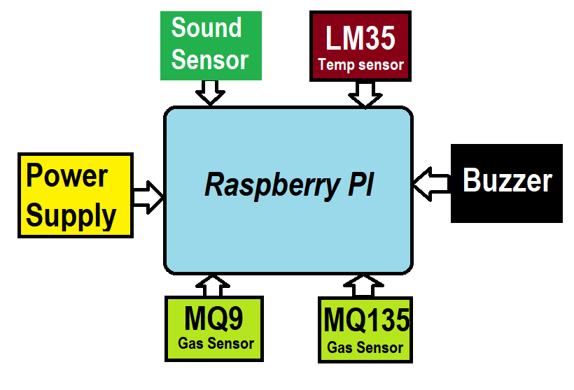
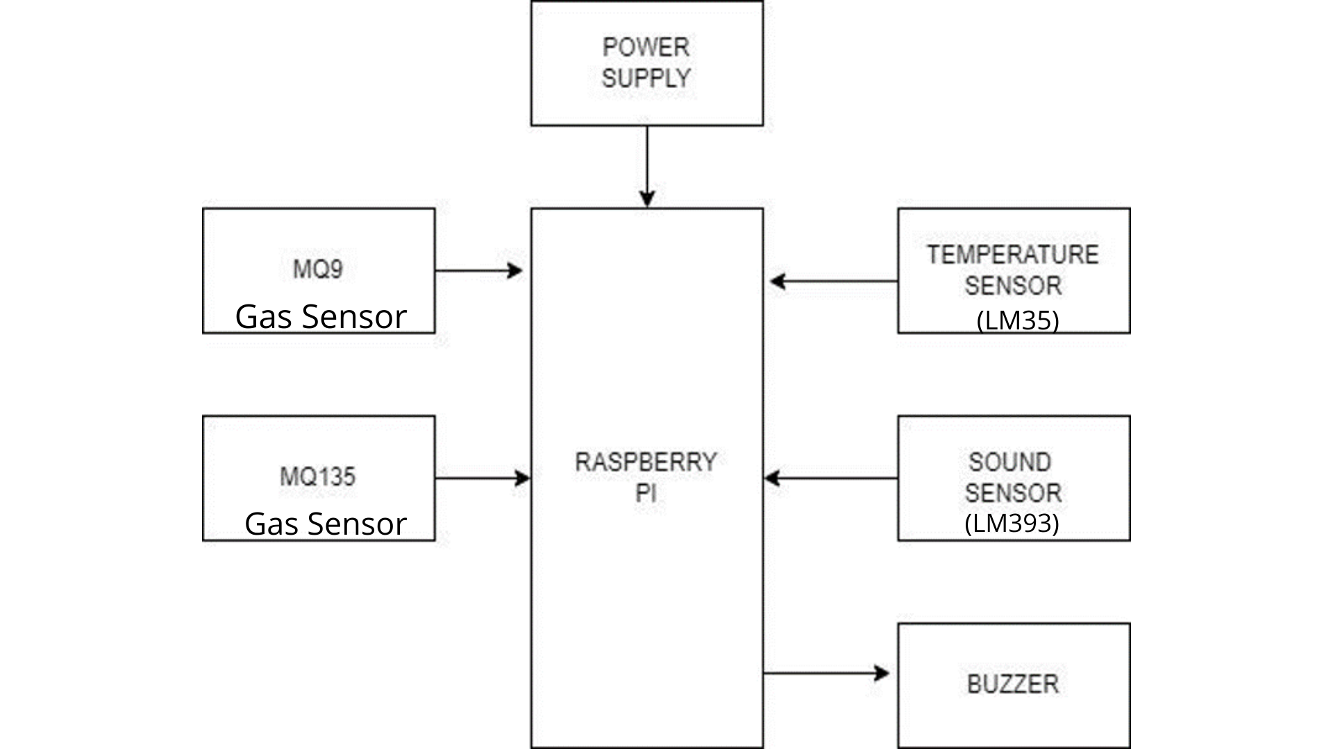
JSPM’s
Imperial College of Engineering and Research,Wagholi,Pune.
(Approved by AICTE,Delhi & Govt. of Maharashtra, affiliated to Savitribai Phule Pune University)
Gat.No.720,Pune-Nagar Road,Wagholi,Pune,412207
Department of Electronics and Telecommunication Engineering
JSPM’s
Imperial College of Engineering and Research,Wagholi,Pune.
(Approved by AICTE,Delhi & Govt. of Maharashtra, affiliated to Savitribai Phule Pune University)
Gat.No.720,Pune-Nagar Road,Wagholi,Pune,412207
Department of Electronics and Telecommunication Engineering
Block Diagram:

Slide 14
JSPM’s
Imperial College of Engineering and Research,Wagholi,Pune.
(Approved by AICTE,Delhi & Govt. of Maharashtra, affiliated to Savitribai Phule Pune University)
Gat.No.720,Pune-Nagar Road,Wagholi,Pune,412207
Department of Electronics and Telecommunication Engineering
JSPM’s
Imperial College of Engineering and Research,Wagholi,Pune.
(Approved by AICTE,Delhi & Govt. of Maharashtra, affiliated to Savitribai Phule Pune University)
Gat.No.720,Pune-Nagar Road,Wagholi,Pune,412207
Department of Electronics and Telecommunication Engineering
Description:
In the system Raspberry Pi is used as main processor. Also there is use of gas sensor, temperature sensor and sound sensor to detect the pollution from environment.
All the reading of the sensor is provide to the Raspberry Pi . System detects the gas pollution, temperature and sound pollution using gas sensor , temperature sensor and sound sensor respectively.
When the air, sound or temp level goes high the buzzer in the circuit is on.
After detection of all pollution it sends towards the raspberry pi processor and raspberry pi sends this data to cloud storage through his in build wifi driver.

Slide 15
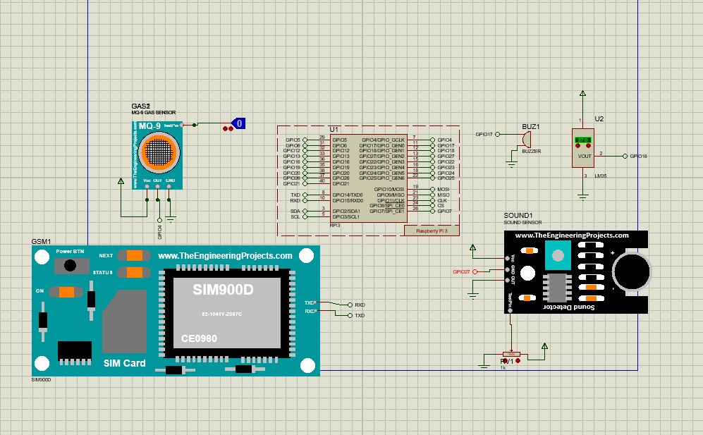
JSPM’s
Imperial College of Engineering and Research,Wagholi,Pune.
(Approved by AICTE,Delhi & Govt. of Maharashtra, affiliated to Savitribai Phule Pune University)
Gat.No.720,Pune-Nagar Road,Wagholi,Pune,412207
Department of Electronics and Telecommunication Engineering
Circuit Diagram

Slide 16
JSPM’s
Imperial College of Engineering and Research,Wagholi,Pune.
(Approved by AICTE,Delhi & Govt. of Maharashtra, affiliated to Savitribai Phule Pune University)
Gat.No.720,Pune-Nagar Road,Wagholi,Pune,412207
Department of Electronics and Telecommunication Engineering
Description:
System detects air and sound pollution. Raspberry Pi is the main processor. Raspberry pi has GPIO pins where all the sensors and output devices are connected.
In the project MQ9 and MQ135 are the two sensors used to detect the air pollution. MQ9 is the sensor which detects air pollution due to gases like methane, carbon monoxide. MQ135 is the gas sensor which detects NH3, CO2 , NOx gases.
These sensors are given as input to the raspberry pi. Sound sensor used to detect the sound pollution and given as input to the raspberry pi.
Buzzer is attached to the system which gives an alert if the pollution level rises too high.
Also the system is featured with the technology that sends alert messages on the municipality mobile. So the required action will be taken.

Slide 17
JSPM’s
Imperial College of Engineering and Research,Wagholi,Pune.
(Approved by AICTE,Delhi & Govt. of Maharashtra, affiliated to Savitribai Phule Pune University)
Gat.No.720,Pune-Nagar Road,Wagholi,Pune,412207
Department of Electronics and Telecommunication Engineering
JSPM’s
Imperial College of Engineering and Research,Wagholi,Pune.
(Approved by AICTE,Delhi & Govt. of Maharashtra, affiliated to Savitribai Phule Pune University)
Gat.No.720,Pune-Nagar Road,Wagholi,Pune,412207
Department of Electronics and Telecommunication Engineering
Advantages:
This system allows authorities to monitor air pollution in different areas and take action against it.
Also authorities can keep a watch on the noise pollution near schools, hospitals and no honking areas.
If system detects air quality and noise issues it alerts authorities so they can take measures to control the issue.

Slide 18
JSPM’s
Imperial College of Engineering and Research,Wagholi,Pune.
(Approved by AICTE,Delhi & Govt. of Maharashtra, affiliated to Savitribai Phule Pune University)
Gat.No.720,Pune-Nagar Road,Wagholi,Pune,412207
Department of Electronics and Telecommunication Engineering
JSPM’s
Imperial College of Engineering and Research,Wagholi,Pune.
(Approved by AICTE,Delhi & Govt. of Maharashtra, affiliated to Savitribai Phule Pune University)
Gat.No.720,Pune-Nagar Road,Wagholi,Pune,412207
Department of Electronics and Telecommunication Engineering
Applications:
Industrial pollution monitoring.
Public places.
School area.
Environmental Section.

Slide 19
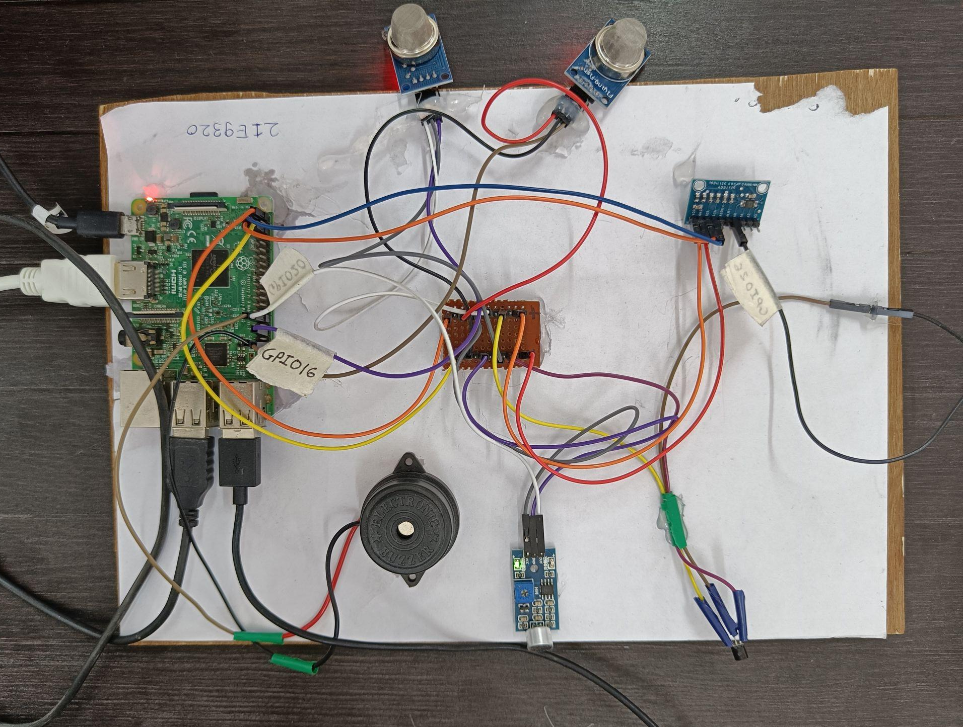
JSPM’s
Imperial College of Engineering and Research,Wagholi,Pune.
(Approved by AICTE,Delhi & Govt. of Maharashtra, affiliated to Savitribai Phule Pune University)
Gat.No.720,Pune-Nagar Road,Wagholi,Pune,412207
Department of Electronics and Telecommunication Engineering
Model:

Slide 20
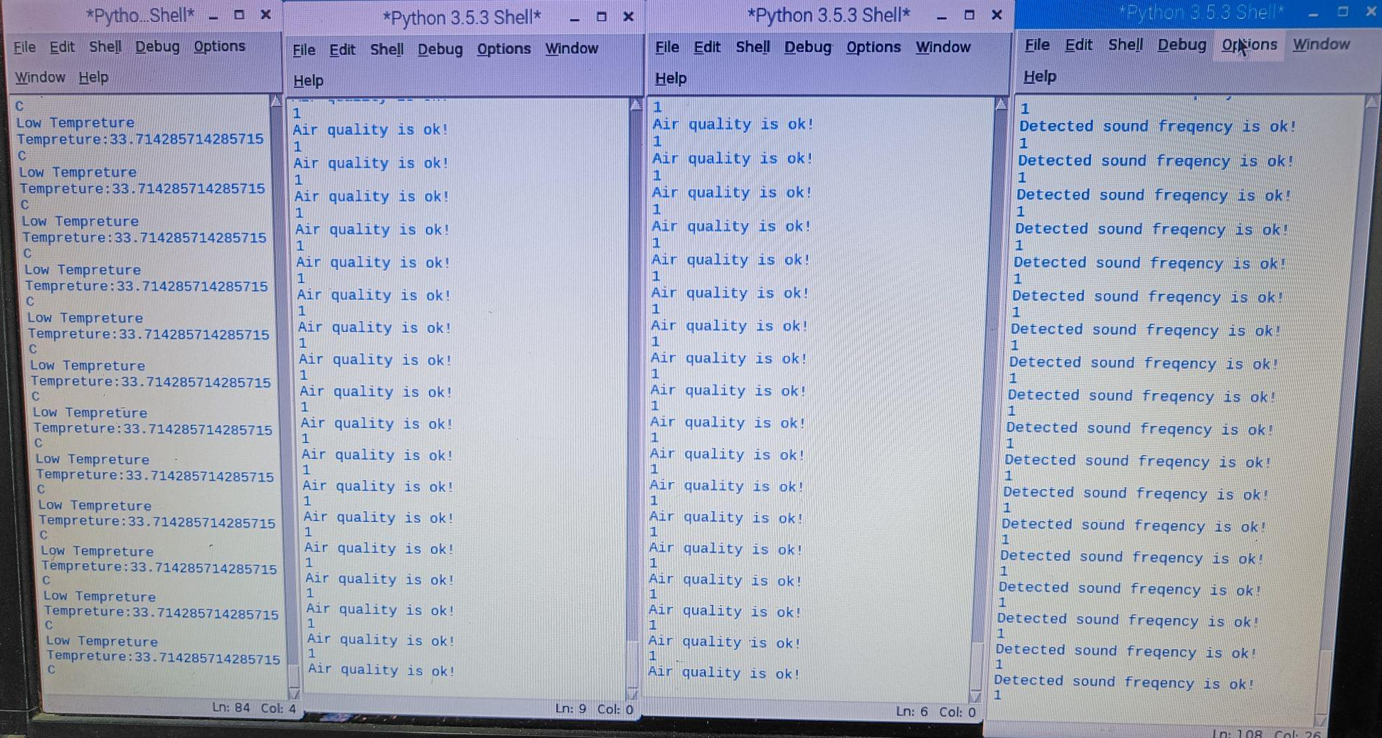
SPM’s
Imperial College of Engineering and Research,Wagholi,Pune.
(Approved by AICTE,Delhi & Govt. of Maharashtra, affiliated to Savitribai Phule Pune University)
Gat.No.720,Pune-Nagar Road,Wagholi,Pune,412207
Department of Electronics and Telecommunication Engineering
Obtained Result:

Slide 21
JSPM’s
Imperial College of Engineering and Research,Wagholi,Pune.
(Approved by AICTE,Delhi & Govt. of Maharashtra, affiliated to Savitribai Phule Pune University)
Gat.No.720,Pune-Nagar Road,Wagholi,Pune,412207
Department of Electronics and Telecommunication Engineering
References:
L.Ezhilarasi, K.Sripriya, A .Suganya, K.Vinodhini, “ A System For Monitoring Air And Sound Pollution Using Arduino Controller With Iot Technology.” , International Research Journal in Advanced Engineering and Technology (IRJAET)
Mahantesh B Dalawai, Siva Yellampalli, Pradeep S.V, “IOT Based Air and Noise Pollution Monitoring in Urban and Rural Areas, Important Zones like Schools and Hospitals in Real Time.”, International e-Journal for Technology and Research-2017.
Arushi Singh, Divya Pathak, Prachi Pandit1, Shruti Patil, P Priti. C. Golar , “IOT based Air and Sound Pollution Monitoring System.” International Journal of Advanced Research in Electrical,
A. Sumithra, J.Jane Ida, K. Karthika , S. Gavaskar, “A Smart Environmental Monitoring System Using Internet Of Things.” International Journal of Scientific Engineering and Applied Science (IJSEAS) – Volume-2, Issue-3, March 2016
JSPM’s
Imperial College of Engineering and Research,Wagholi,Pune.
(Approved by AICTE,Delhi & Govt. of Maharashtra, affiliated to Savitribai Phule Pune University)
Gat.No.720,Pune-Nagar Road,Wagholi,Pune,412207
Department of Electronics and Telecommunication Engineering

Slide 22
JSPM’s
Imperial College of Engineering and Research,Wagholi,Pune.
(Approved by AICTE,Delhi & Govt. of Maharashtra, affiliated to Savitribai Phule Pune University)
Gat.No.720,Pune-Nagar Road,Wagholi,Pune,412207
Department of Electronics and Telecommunication Engineering
Mohannad Ibrahim , Abdelghafor Elgamri , Sharief Babiker . Ahmed Mohamed, “Internet of things based smart environmental monitoring using the Raspberry-Pi computer.” Fifth International Conference on Digital Information Processing and Communications (ICDIPC), 2015
Giovanni B. Fioccola , Raffaele Sommese, Imma Tufano, Roberto Canonico, Giorgio Ventre, “ Pollution: An efficient cloud-based management of IoT devices for air quality monitoring.” IEEE 2nd International Forum on Re- search and Technologies for Society and Industry Leveraging a better tomor- row (RTSI), 2016
SRM.ArthiShri, NB.Keerthana, S.Sandhiyaa,P.Deepa, D.Mythili,” Noise and Air Pollution Monitoring System Using IOT.” SSRG International Journal of Electrical and Electronics Engineering– (ICETM-2017) - Special Issue- March 2017.
Seung Ho Kim ; Jong Mun Jeong ; Min Tae Hwang ; Chang Soon Kang, “De- velopment of an IoT-based atmospheric environment monitoring system.” In- ternational Conference on Information and Communication Technology Con- vergence (ICTC)., 2017

